Slide 1


M365 Case Studies

Slide 2

Turn 10 - Dynamics 365
Front end integration
Player
Updates
Marketing
CPM
Event announcements
Customer Voice
Surveys
Implementation
Data management
Newsletter Embedded
Front end Embedded
Player
Title Metadata
Opt-in
Survey submissions
Coding
Newsletter
NGP/DSR
Topic based Segmentation
Optout
Engagement Overview​
Turn 10 identified the need for a unified platform to engage and manage Player data and communications for their popular game Forza.
Affirma developed custom extensions for Dynamics core elements and used front-end integrations to capture/update player data.
Together with Turn 10, we regularly release community campaigns, including for their insiders program which launched in 2024
Dynamics CRM

Slide 3
ACS – Dynamics Onboarding Tool and Reporting
Business Need
Azure Comunication Services was leveraging Azure DevOps to manage product development tasks and sales opportunities. They needed a way to increase visibility and collaboration between the product development team and sales team so that development priorities aligned with revenue opportunities.
What We Did
Affirma migrated the sales team's ADO driven process to a Dynamics solution that integrated with the product development team's ADO process.
Designed and implemented a Dynamics solution for ACS team
Created an automatic customer onboarding solution with Microsoft Forms and Power Automate
Integrated CRM with ADO through automated syncing and bridging business and engineering
Implemented a Power BI reporting solution for data-driven business/customer needs assessment
Developed a manageable CRM infrastructure to enhance customer relationship management
Integrated a robust Customer Voice-based survey
Trained the ACS team to customize the CRM solution independently
Outcome
Affirma designed and implemented a state-of-the-art, self-sufficient business solution, including a new CRM environment integrated with ADO, Outlook, and Dynamics 365. We also developed Power BI reporting for insights and forecasting, along with providing necessary infrastructure and engineering support.

Slide 4


Xbox – Dynamics Customer Support
Business Need
Microsoft’s Xbox Customer Support team came to Affirma for help improving their customer service and case escalation processes. They had many siloed systems in place for triaging and escalating support cases placed by end users of Xbox. This resulted in fragmented communications, and almost no process automation or reporting.
What We Did
Affirma gathered requirements and recommended significant process improvements.
Our team then designed a solution on Dynamics 365 to support the entire lifecycle of support cases. This included intake, triage, communication, resolution and reporting.
Dynamics 365 was integrated with another Customer Support platform at Microsoft which is built on Azure Dev Ops (ADO).
Affirma performed extensive quality assurance on the Dynamics 365 solution across functionality and user roles. This included test planning, full QA, bug fixing, UAT, production testing, and ongoing support post-deployment for minor iterations.
Affirma continues to engage with the XBOX to enhance functionality and reporting as needed.

Slide 5


Rare Studios – Insider Dynamics Program
Business Need
Affirma supports and maintains Rare’s Dynamics instance for their highly popular game, Sea of Thieves. A primary use case Dynamics for Rare is to run their insider community for their most passionate gamers.
Rare had the following needs to expand their Dynamics solution.
Improved data warehouse solution that could consume data from multiple sources and pipelines
Process partner data in a time effective way
What We Did
Designed, executed, and delivered two complex Azure Data Factory solutions for Rare's data warehouse requirement.
Update Dynamics objects, workflows, and permissions to allow data integration with the new data warehouse.

Slide 6
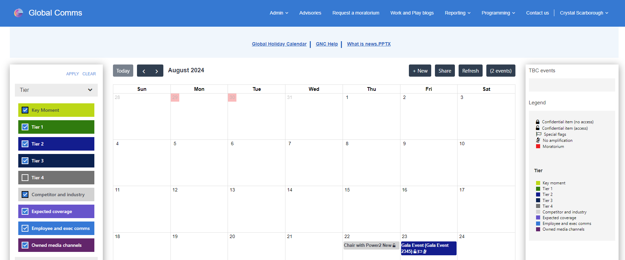
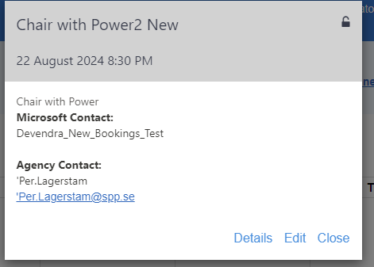
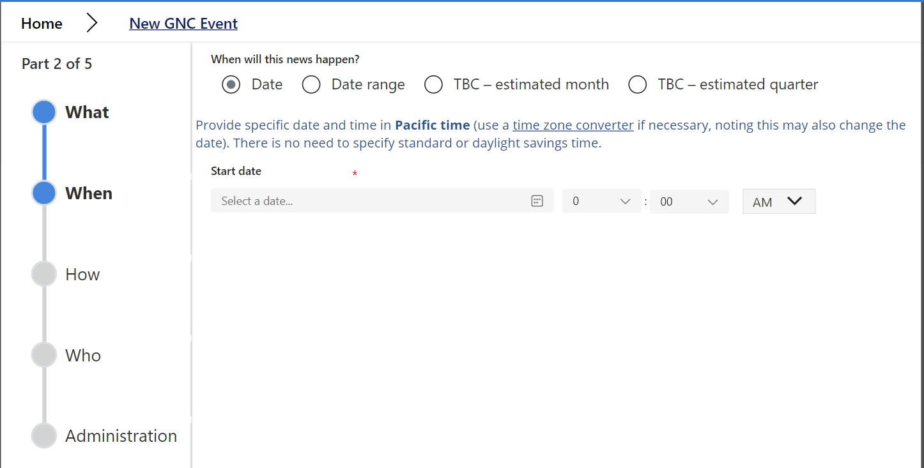
PR HQ - Power Pages Portal
Engagement Overview​
We engaged with Microsoft PR HQ to enhance their Global News Communications system into a one-stop shop improving user experience for finding global news entries and other communication information.
Consulting, planning, and executing a Power Pages Portal hosting a PowerApps application including Global News calendar, forms, Advisory listing and much more.
Updated their current SPFx solution on portal pages using Liquid coding. The idea was to keep the functionality the same with a few enhancements.
Taking a manual process for publication verification to their Frequent Fliers (including news outlets and influencers) to the next level with automation!

